Slide 1
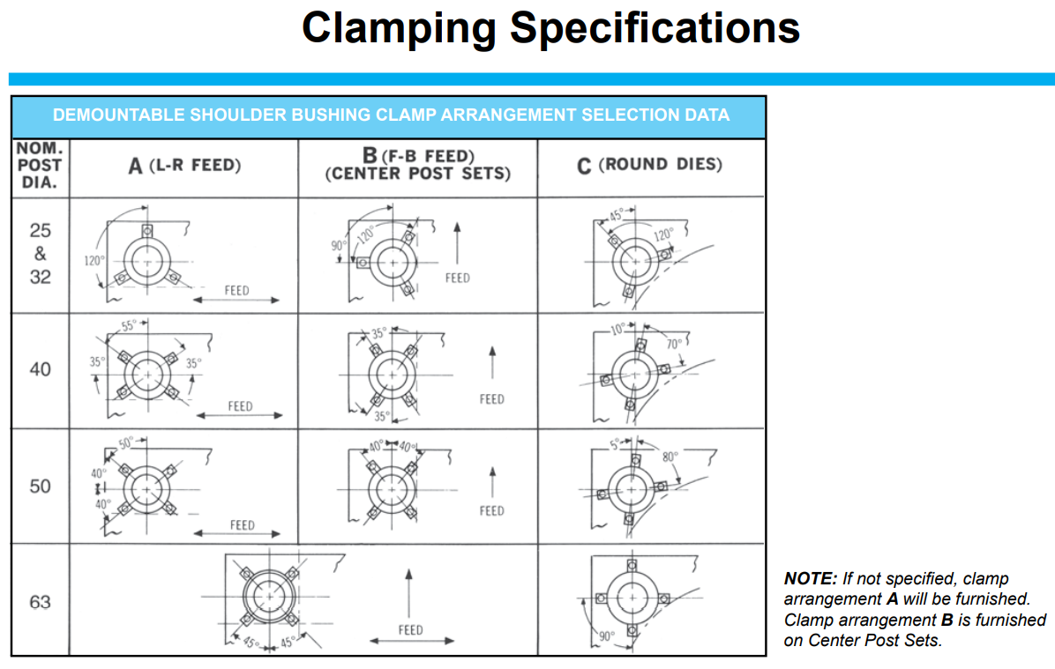

Slide 2
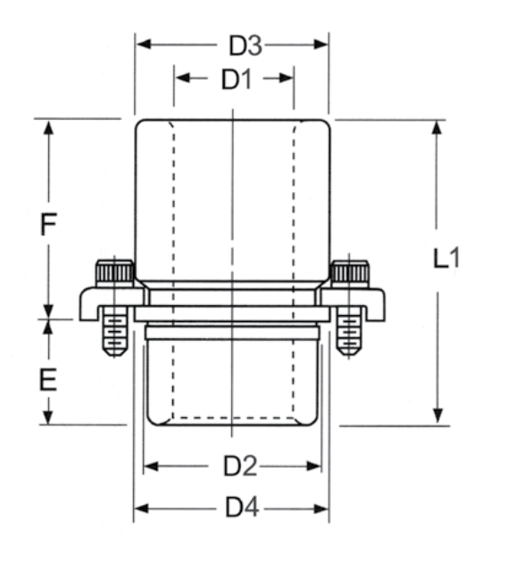
Danly
c
a
m
b
c1

Slide 3
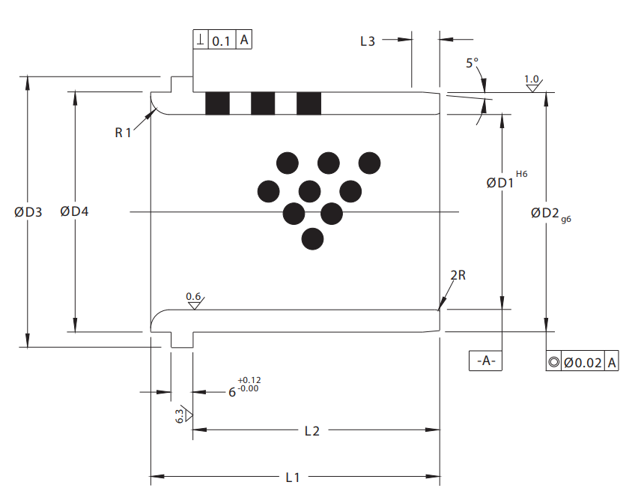
NAAMS
a
c1
c
b
e
f+e

Slide 4
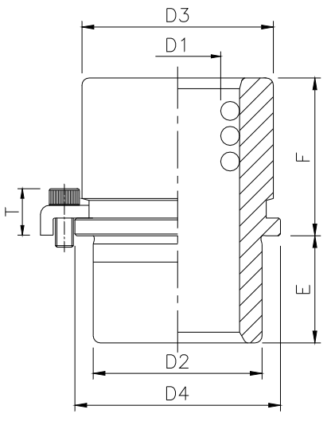
c
MDL
a-BB
m
b
c1

